Slide 1
De‑identification of Structured EHR Using Machine Learning Techniques for RADx-rad
Xiaoqian jiang
University of Texas health science center at houston

Slide 2
Motivation
Before local data generation sites submit to the RADx-rad data coordination center, one common task is de-identification.
Data de-identification can be very tedious and error-prone when done manually. This is because it requires a lot of attention to detail and can be easy to make mistakes.
The RADx-rad team will help to automate and optimize the de-identification and transformation process, improving the efficiency of data preparation.

Slide 3
ML-Based PHI Field Detection and Privacy Mitigation
Advanced Mapping Tool to Convert Source Data to Target Data Model with Mitigated Privacy Risks

Slide 4
Our previous work on this topic

Slide 5
RADx-rad DCC: Data Core – Key Activities
Use of Common Data Elements (CDEs)
NIH minimum CDEs for prospective human subject studies
Recommend CDEs for each FOA research area
IMI – CDE mapping tool
Data collection
Secure FTP for data submission
Quality assurance of submitted datasets
Data sharing (https://www.radxrad.org/data-core-resources/)
Privacy protection tools
Subject ID generation tool
Zip Code truncation tool
Date-shifting tool

Slide 6
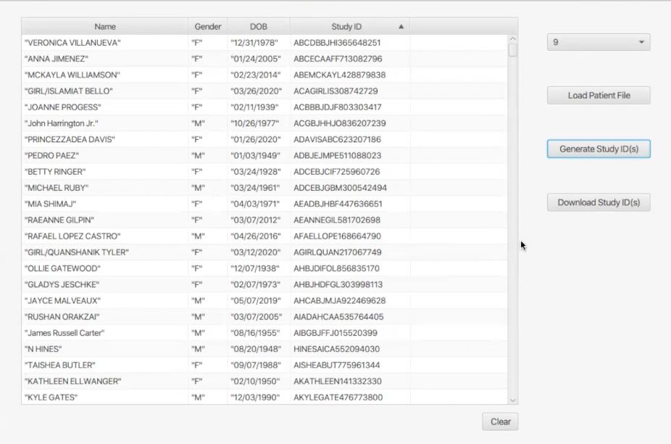
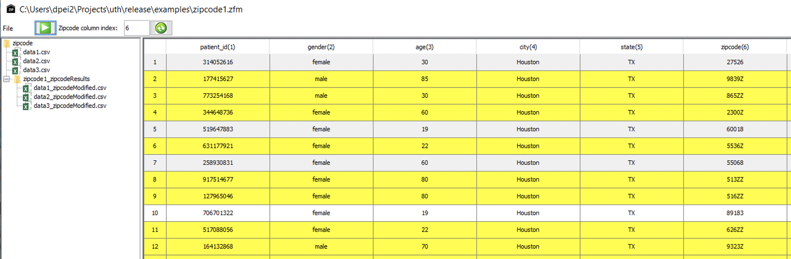
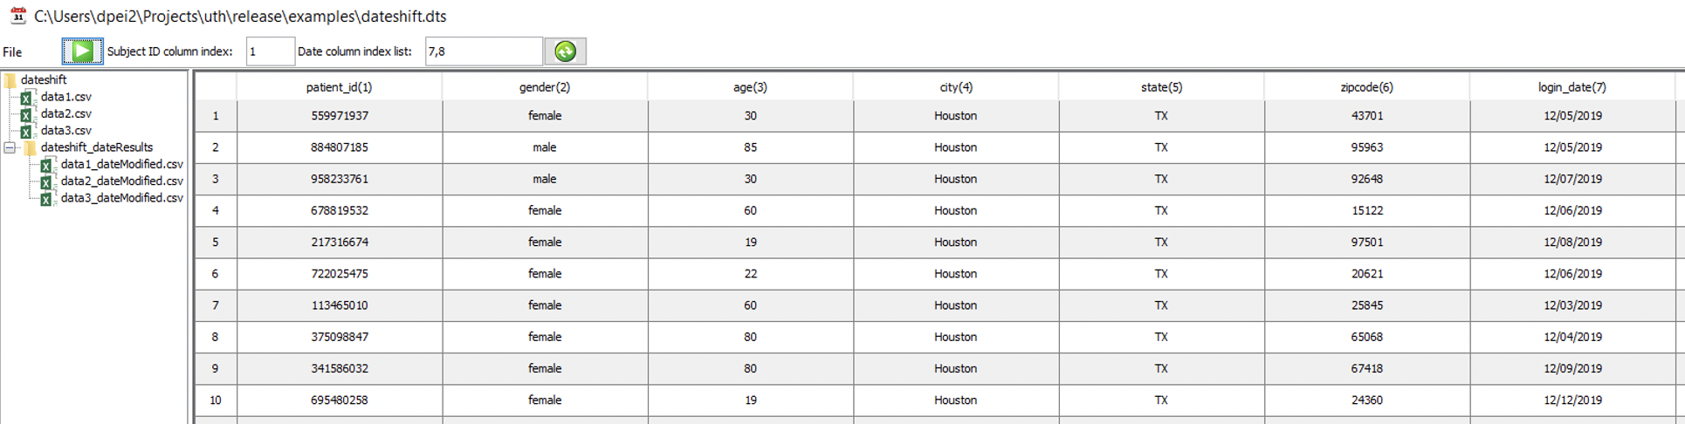
RADx-rad DCC: Data Core – Accomplishments
Data sharing – privacy protection tools
Subject ID generation tool
Zip Code truncation tool
Date-shifting tool

Slide 7
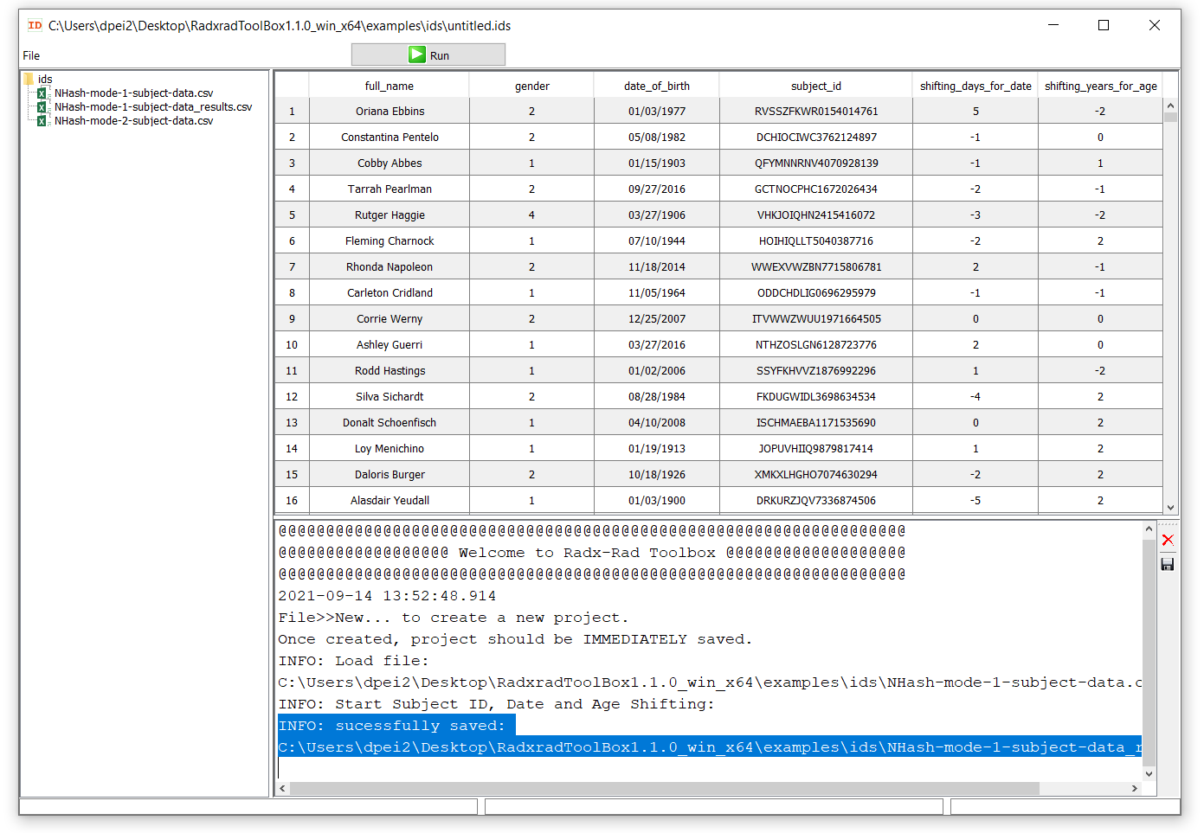
Data Core Privacy Tools Accomplishments
Tool to provide hashed Subject_IDs
Provide and track random days to shift for human subject dates (-5 to +5 days)
Provide and track years to shift age of human subjects (-2 to + 2 years)
Zip Code truncation by awardees

Slide 8
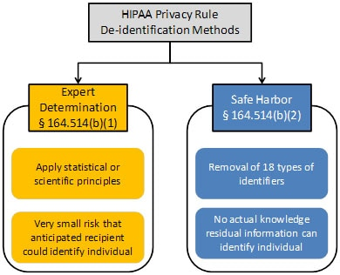
The De-identification Standard
Category | Data Elements | Category | Data Elements
(A) Names | First and last name, middle initial, suffix | (J) Account numbers | Account number
(B) Geographic subdivisions | Street address, city, county, precinct, ZIP code | (K) Certificate/license numbers | Certificate/license number
(C) Dates | birth date, admission date, discharge date, death date, all ages > 89 and all elements of dates (including year) indicative of such age | (L) Vehicle identifiers and serial numbers | Vehicle identifier number, license plate number
(D) Telephone numbers | Area code, phone number | (M) Device identifiers and serial numbers | Device identifier number, serial number
(E) Fax numbers | Area code, fax number | (N) Web URLs | URL
(F) Email addresses | Email address | (O) Internet Protocol (IP) addresses | IP address
(G) Social security numbers | Social security number | (P) Biometric identifiers | Fingerprints, voiceprints
(H) Medical record numbers | Medical record number | (Q) Full-face photographs | Photographs
(I) Health plan beneficiary numbers | Health plan beneficiary number | (R) Other unique identifiers | Any other unique identifying number, characteristic, or code, except as permitted by paragraph (c) of this section
Figure 1. Two methods to achieve de-identification in accordance with the HIPAA Privacy Rule.

Slide 9
Some Common Examples of RegExes
To find | Use this RegEx | Example of match
Email addresses | ^[\w\.=-]+@[\w\.-]+\.[\w]{2,3}$ | T.Simpson@Netwrix.com
U.S. Social Security numbers | \b(?!000|666|9\d{2})([0-8]\d{2}|7([0-6]\d))([-]?|\s{1})(?!00)\d\d\2(?!0000)\d{4}\b | 513-84-7329
IPV4 addresses | ^\d{1,3}[.]\d{1,3}[.]\d{1,3}[.]\d{1,3}$ | 192.168.1.1
Dates in MM/DD/YYYY format | ^([1][12]|[0]?[1-9])[\/-]([3][01]|[12]\d|[0]?[1-9])[\/-](\d{4}|\d{2})$ | 05/05/2018
MasterCard numbers | ^(?:5[1-5][0-9]{2}|222[1-9]|22[3-9][0-9]|2[3-6][0-9]{2}|27[01][0-9]|2720)[0-9]{12}$ | 5258704108753590
Visa card numbers | \b([4]\d{3}[\s]\d{4}[\s]\d{4}[\s]\d{4}|[4]\d{3}[-]\d{4}[-]\d{4}[- ]\d{4}|[4]\d{3}[.]\d{4}[.]\d{4}[.]\d{4}|[4]\d{3}\d{4}\d{4}\d{4})\b | 4563-7568-5698-4587
American Express card numbers | ^3[47][0-9]{13}$ | 34583547858682157
U.S. ZIP codes | ^((\d{5}-\d{4})|(\d{5})|([A-Z]\d[A-Z]\s\d[A-Z]\d))$ | 97589
Telephone/FAX/MRN/Account numbers | \b((\d[\(\)\-\']?\s?){6}([\(\)\-\']?\d)+|(\d[\(\)\-.\']?){7}([\(\)\-.\']?\d)+\b, \b(\d{5}[A-Z0-9]*)\b, \b([A-Z0-9\-/]{6}[A-Z0-9\-/]*)\b | XXX-XX-XXXX, XXX-XXX-XXXX, XXX-XXXXXXXX, etc.
Dates | \b(.*?(?=\b(\d{1,2}[-./\s]\d{1,2}[-./\s]\d{2}|\d{1,2}[-./\s]\d{1,2}[-./\s]\d{4}|\d{2}[-./\s]\d{1,2}[-./\s]\d{1,2}|\d{4}[-./\s]\d{1,2}[-./\s]\d{1,2})\b))\b | YYYY/MM-YYYY/MM, MM/YYYY-MM/YYYY, MM/DD-MM/DD, etc.

Slide 10
Existing Method Could Fail
Expert determination: human can make mistakes; non-sustainable (human’s energy is limited)
Regular expression: can’t exhaust all possibilities, e.g.:
SSN: XXXXXXXXXX, XXX-XX-XXXX, XXX-XXX-XXXX, what else?
Phone: (XXX)XXXXXXX, (XXX)XXX-XXXX, XXX-XXX-XXXX, what else?
Postal code XXXXX, XXXXX-XXXX
DOB: YYYY/MM , MM/YYYY, MM/YY, MM/DD/YY , MM/DD/YYYY, YY/MM/DD what else?
Salutation: Dr\.|Mr\.|Mrs\.|Ms\.|Miss, what else?
Address: 'street', 'avenue', 'road', 'boulevard', 'drive', 'trail', 'way', 'lane', 'ave', 'blvd', 'st', 'rd', 'trl', 'wy', 'ln', 'court', 'ct', 'place', 'plc', 'terrace', 'ter’ what else:
XXX-XXXXXXX
XXX-XXXXXXX
M/DD/YYYY
Sir/Madam
'highway', 'freeway', 'autoroute', 'autobahn', 'expressway', 'autostrasse', 'autostrada', 'byway', 'auto-estrada', 'motorway', 'boulevard', 'alley', 'bay’, 'gardens', 'gate', 'grove', 'heights', 'highlands', 'mews’, 'pathway', 'terrace', 'trail', 'vale', 'view', 'walk', 'close’, 'court', 'place', 'cove', 'circle', 'crescent', 'square', 'loop', 'hill','causeway', 'canyon', 'parkway', 'esplanade', 'approach', 'parade', 'park','plaza', 'promenade', 'quay', 'bypass’,'pkwy.'

Slide 11
Machine learning model to detect PHI from structured data

Slide 12

Detecting Sensitive Information with Feature Engineering
Using engineered features, ML can be trained to learn if a column is PHI or not.
The features we used are:
1. Data type (categorical, datetime, integer, float, string)
Categorical data type fields are likely to be PHI: e.g. gender (M/F or 0/1), race (White/Black/Asian/etc. or 0/1/2/3)
Datetime data types are very likely to be PHI: e.g. birthdate, check-in/out date, death date, …
String data types can sometimes be PHI: e.g. gender, race, address,…
Numerical data types is unlikely to be PHI: e.g. vital sign test, lab test results, etc.

Slide 13

Detecting Sensitive Information with Feature Engineering
2. Uniqueness count, unique ratio (%): how many unique value
If the items in of field is unique among all patients, it is very likely to be PHI, e.g. SSN number, MRN number, Encounter number, …
3. Statistics: min, max, mode, median, sum, variance, std, skewness, kurtosis, quantiles, median_abs_deviation
If a column is numerical data type, their statistics also tells information about whether they are PHI
For example, if their min values is a very large number, say 1242642567, then it is very likely to be a PHI, e.g. SSN/MRN
On the other hand, non-PHI lab tests/vital signs usually do not have such numbers of such scale

Slide 14
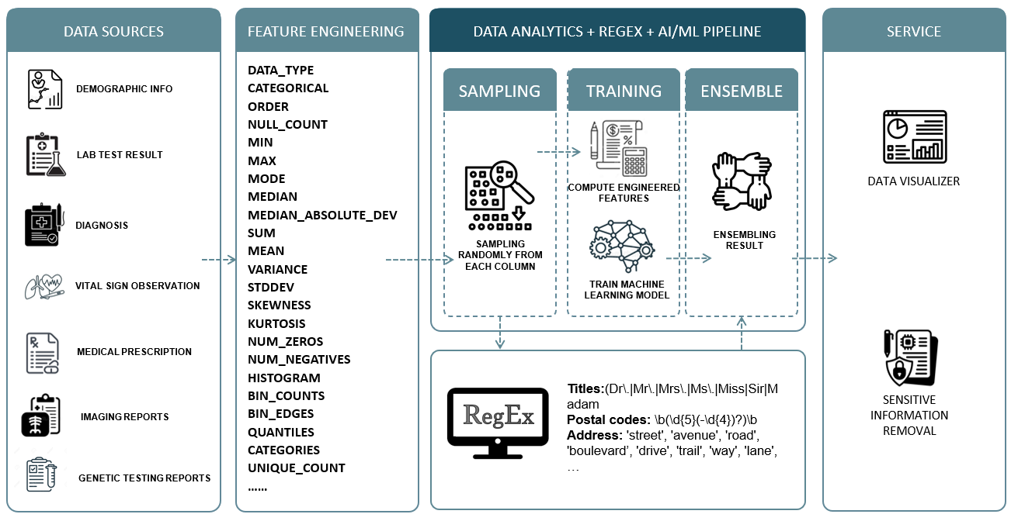

Slide 15
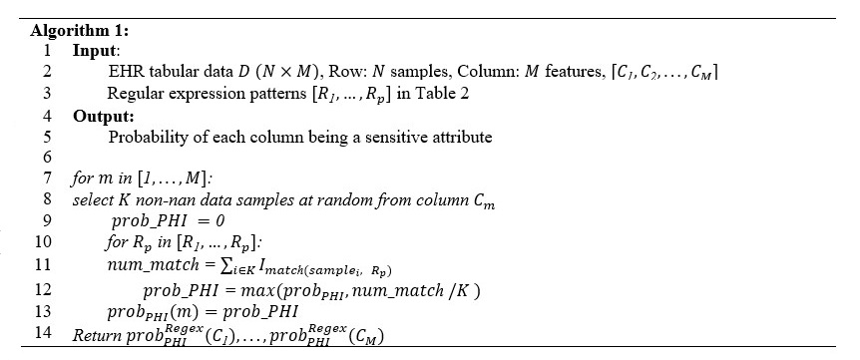
Algorithm I. PHI Detection using ML

Slide 16
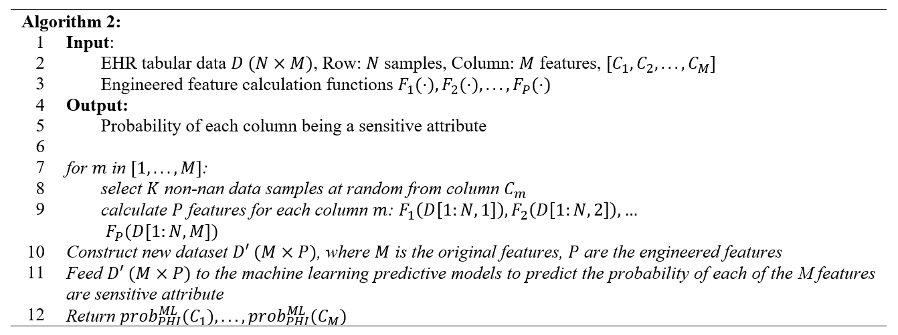
Algorithm II. Ensemble Algorithm

Slide 17
PHI Detection Toolkit

Slide 18
The PHI Data Scan Tool
Database
Read
Profile
Scan
Report
Text Files
Workflow explanation

Slide 19
Prerequisites
Windows 10 or Mac OS
with Python3.8 or Python3.9
with GitHub tools installed
Key python decencies
PYQT6 - Python GUI packages
DataProfiler – Data statistics collection
xgboost – Machine learning Library
SqlAlchemy – Python SQL toolkit and Object Relational Mapper for Database connection
Please refer to https://github.com/chorus-ai/ChoRUS_Privacy_Scan

Slide 20

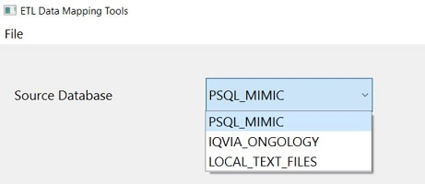
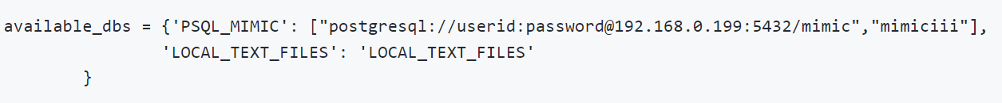
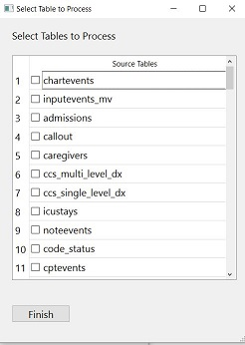
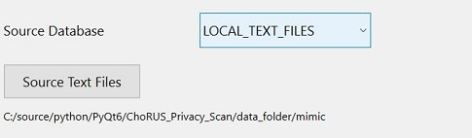
Step 1: Select Database/Table
Select source data
PostgreSQL database - will support more database type soon
Setup in config.py
Select Tables
Folder for CSV Files
Detail user instructions can be found at https://github.com/chorus-ai/ChoRUS_Privacy_Scan/blob/main/User_Instruction.md

Slide 21
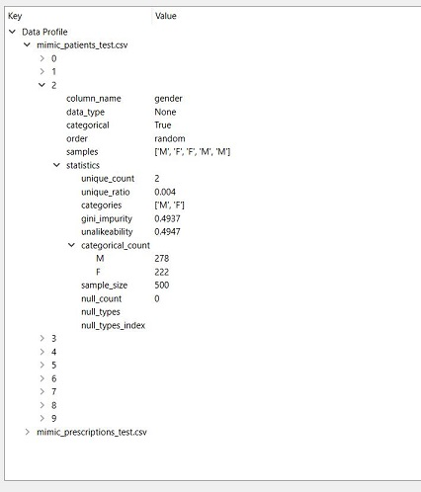

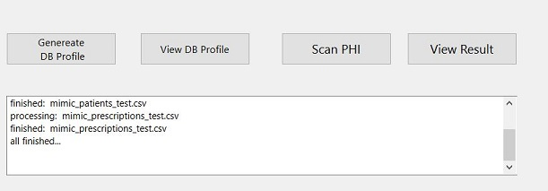
Step 2: Profiling
Select “Generate DB profile” and let the algorithm calculate statistics for each column
The statistics will be used to train the PHI detection algorithm
We will sample 1,000 records for statistics analysis. The setup can be changed in config.py.
Reports can be read on the pop out window

Slide 22

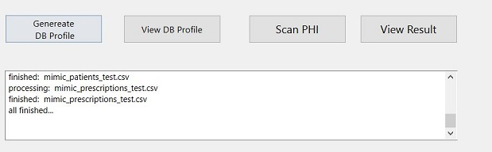
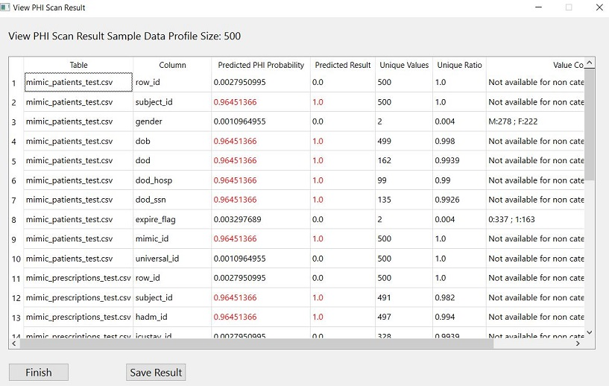
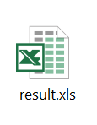
Step 3: Scanning and Reporting
Select “Scan PHI” to run the PHI detection algorithm
Results will show in a tabular format
Can be saved in excel sheet

Slide 23

Step 4: Fill in HIPPA Safe Harbor Checklist
Remove the identified PHI columns or cover the privacy information
Fill in the Checklist form
Share data

Slide 24
Experiments

Slide 25
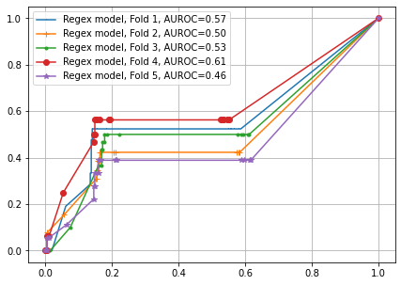
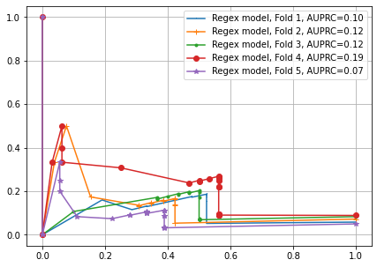
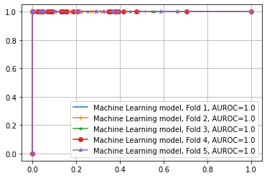
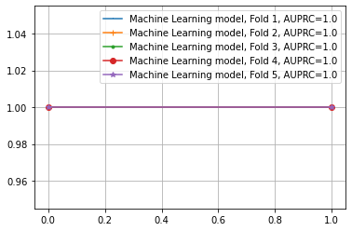
Experiment
ML model is trained on local structured EHR data:
The data contains 5,000 patients (rows)
Near 1,000 columns with 67 columns being PHI
The model engineered 37 statistical values from each column to be the features to train the algorithm
Regular Expression
Machine Learning

Slide 26
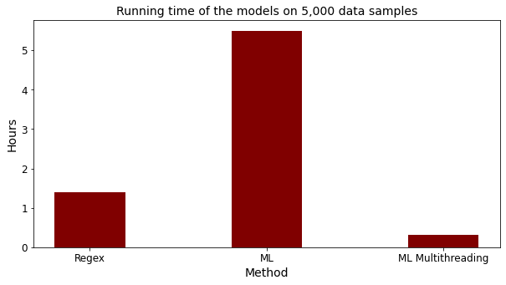
Result
Table 1. Five-fold cross validation performances of the models on sensitive attribute dentification: mean(std).
 | AUROC | AUPRC | sensitivity | specificity | precision | NPV | accuracy | F1
Regex | .540(.052) | .127(.039) | .479(.064) | .841(.013) | .187(.051) | .956(.008) | .816(.015) | .268(.062)
ML | 1.0(0.0) | 1.0(0.0) | 1.0(0.0) | 1.0(0.0) | 1.0(0.0) | 1.0(0.0) | 1.0(0.0) | 1.0(0.0)
Ensemble | 1.0(0.0) | 1.0(0.0) | 1.0(0.0) | 1.0(0.0) | 1.0(0.0) | 1.0(0.0) | 1.0(0.0) | 1.0(0.0)
Figure 1. The running time of the Regex model and the ML model. The running time of regex model is for completely screening all patterns of all 899 columns in the dataset. The running time for ML model is for completely calculating all engineered features of all

Slide 27
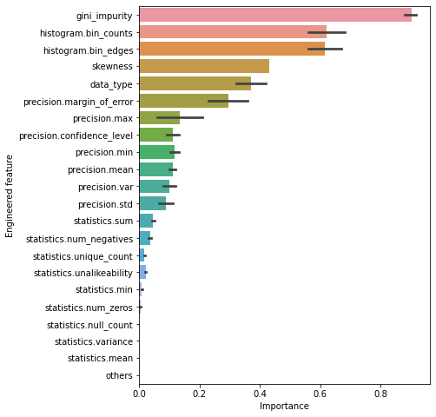
Explainability
Top-20 important features ranking by their importance
Examples:
Gini impurity is the most important feature since it represents the impurity or heterogeneity of a set of labels (so that medical IDs has the largest gini impurity).
Bin counts/bin edge values of histogram is largely dependent on the feature being categorical or continuous
Skewness measures the symmetry of the sample distribution and data type such as string, datetime, float, int, etc. also tells whether an attribute likely contains sensitive information.
Figure 2. Feature importance of the engineered features. Importance is normalized to the range of [0,1]. The error bar means standard deviation calculated from five-fold cross validation.

Slide 28
Acknowledgement
Thanks to the leadership of Dr. Lucila Ohno-Machado and Dr. Hua Xu
Thanks to Dr. Kai Zhang and Luyao Chen for the implementation
Thank Pritham Ram for the team organization
Thank NLM for the funding support U24LM013755

Slide 29

Questions

